Slide 1

Prudential Insurance Risk Prediction
– Vivek Gulavani

Slide 2

Problem Statement
Insurance Approval is Complex Process
It involves collection of extensive personal and medical information
Analyzing the information and assigning a Risk is a manual process
Manual Process causes delay in Insurance approval
Automation of Risk Predication is required to Improve Business Efficacy

Slide 3
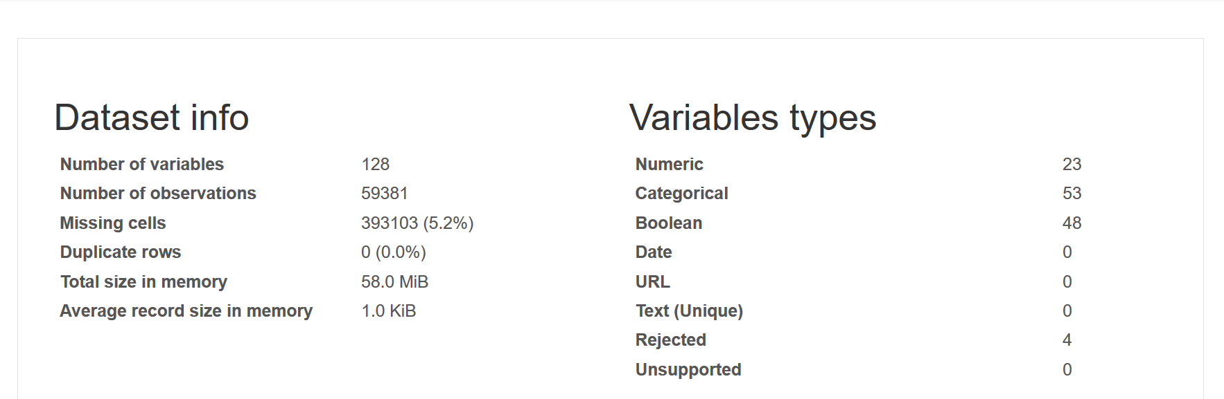
Dataset Overview

Slide 4
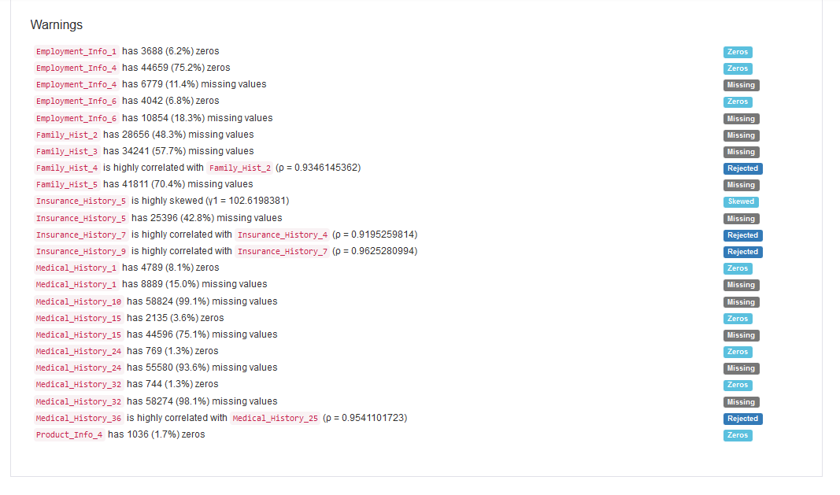

Slide 5
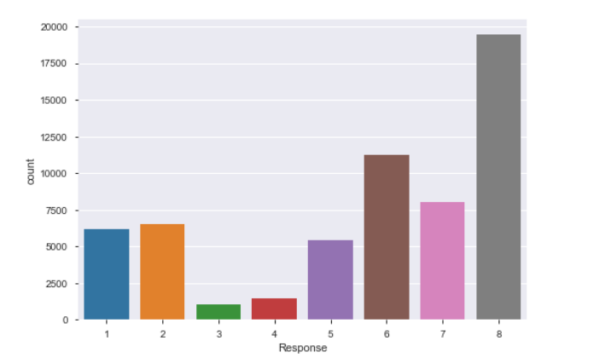
Type of ML Problem - Multilevel Classification OR Regression
127 Features
Target
Response
Unbalanced Distribution

Slide 6
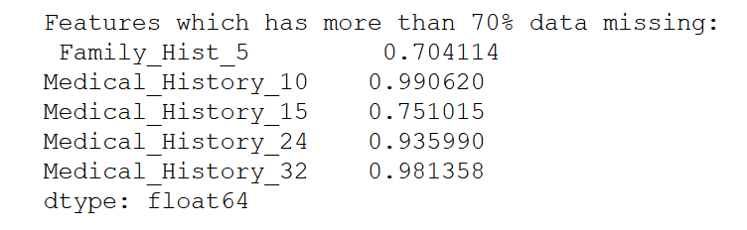
Data Transformation
Dropped features with > 70% missing data
Label Encoding of Product_Info_2
Transform Categorical Column
Impute Missing Values with Mean
Imputation of Missing Values
Drop Features with high Multi-collinearity

Slide 7
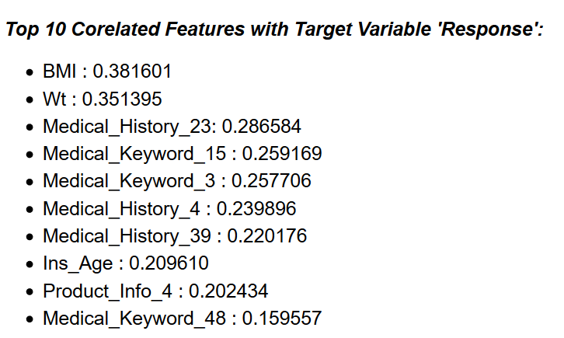
Correlation With Target Variable

Slide 8
ML Algorithms Used
Classification
Decision Tree
Random Forest
GridSeachCV
RandomizedSearchCV

Slide 9
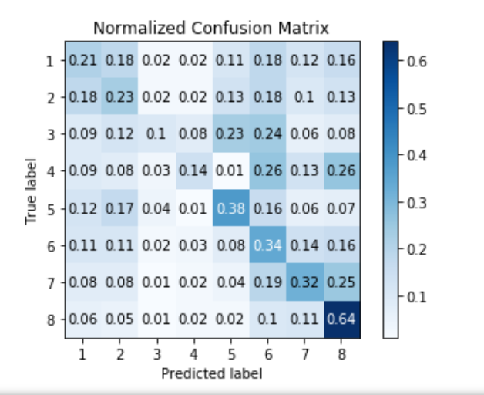
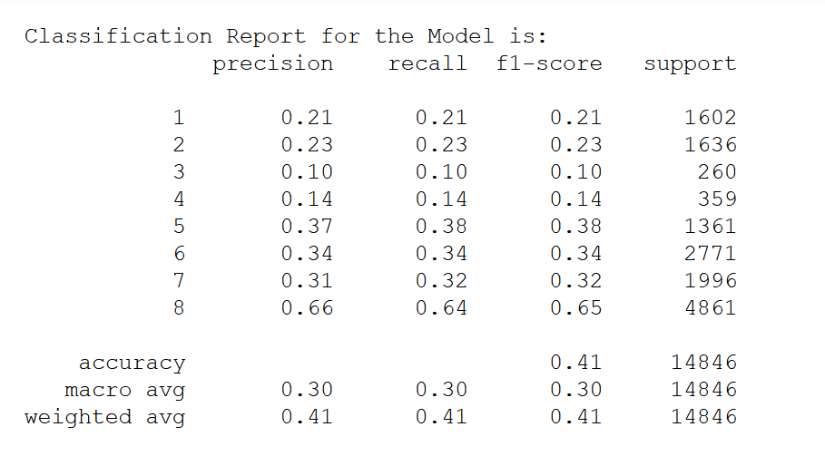
Decision Tree Classifier
Train – Test Split: 75:25
Accuracy

Slide 10
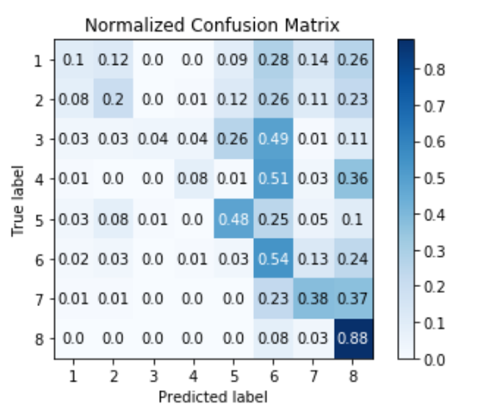
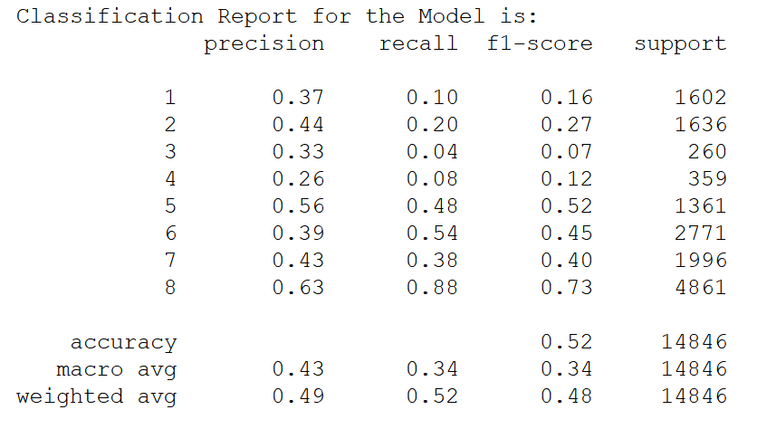
Decision Tree Classifier – GridSearchCV
Train – Test Split: 75:25
Accuracy

Slide 11
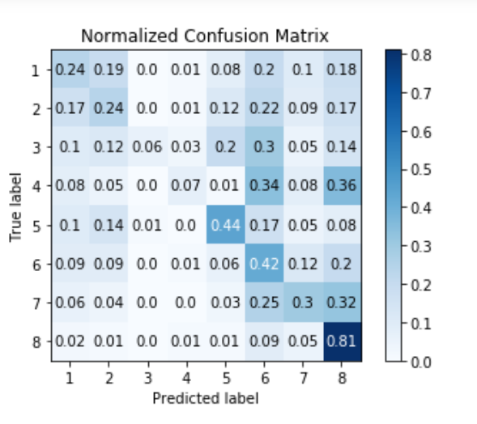
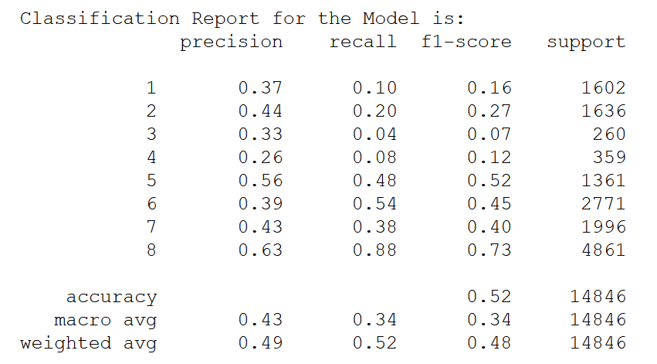
Random Forest Classifier
Train – Test Split: 75:25
Accuracy

Slide 12
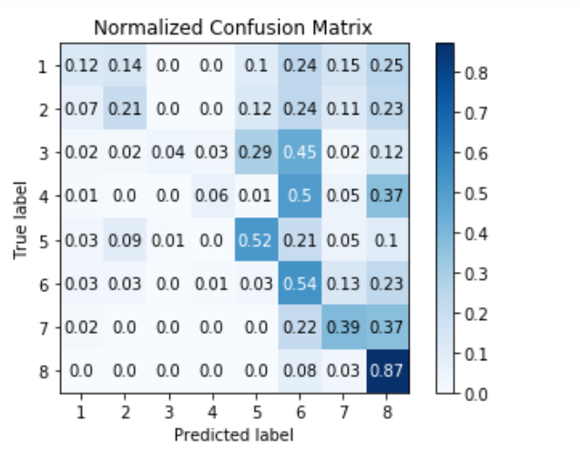
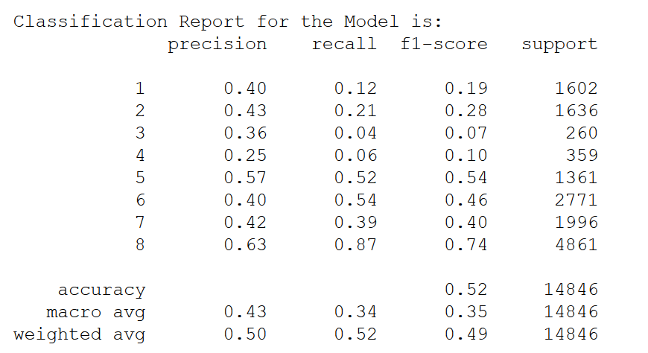
Random Forest Classifier – RandomizedSearchCV
Train – Test Split: 75:25
Accuracy

Slide 13
Dimensionality Reduction
Methods Used
PCA
Negative Impact on Model Accuracy
RFE

Slide 14
Model Comparison - Classification
Selected Classification Model
RF With RandomizedSearchCV
Highest Accuracy – RF with RandomizedSearchCV – 0.524
Highest Precision – RF with RandomizedSearchCV – 0.5
Observations
Accuracy of prediction is lower.
Data is unbalanced so recall for Response value ‘8’ is highest and very low for ‘3’ and ‘4’
Tried Using SMOTE to balance the data however accuracy reduced with increase in recall for ‘3’ and ‘4’
Tried Using PCA and RFE for dimensionality reduction however it further reduced the accuracy

Slide 15
Conclusion
Selected Model for Prediction
‘Random Forest Classification’ with Hyper Parameter Tuning

